Slide 1
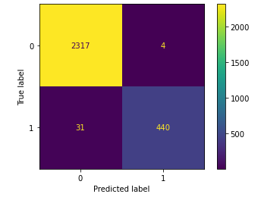
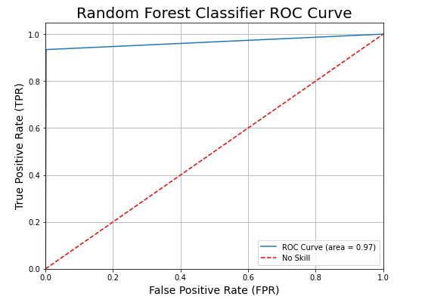
Salifort Motors
Employee Retention Predictive Model
There has been high employee turnover at Salifort Motors
metric inclusive of firing and quitting
Salifort Motors requests a model to predict employee turnover & retention.
Drafted a proposal using the PACE workflow
Retrieved dataset, performed EDA, feature transformation, and modeling
Created two predictive models:
Logistic Regression model
Random Forest Classifier
Random Forest Classifier is the champion model
Precision Score: 99.0%
Recall Score: 93.4%
F1 Score: 96.2%
Accuracy Score: 98.7%
Random Forest Classifier Confusion Matrix
Employee turnover is expensive, the company invests a lot in recruitment, training and upskilling.
A successful predictive model for employee turnover & retention could alleviate these issues and cut costs.
Random Forest Classifier predictive power versus a random guess.
Key metrics identified by the feature importance plot are:
Satisfaction Level, Tenure, Last Evaluation, Number of Projects, Average Monthly Hours
Random Forest Classifier model is the champion model:
Surpasses benchmark of 65% efficacy
Recommend that the model be deployed to further evaluate its efficacy
Recommendations:
Further investigate key metric relationships in relation to notable insights identified in EDA
Notable insights:
Large average hourly disparity per department, disproportionate of office size
Only 5 departments had promotions in the last 5 years, with 51 to 68% of attrition per department being employees with low salaries
Salary should be explored as a continuous variable, so that a Linear Regression analysis can be explored.

